Slide 1
MINI PROJECT ON WELCOME TO KUDLA WEBPAGE
Submitted by
Ankitha K M

Slide 2
Contents
Home
About Us
Contact Us
Blogs

Slide 3
Introduction
Project is on exploring mangalore city
With a help of html5,css and javascript languages webpage has been created.
Location,culture,mangalore cuisine,and famous places to visit in mangalore along with video has been done.
In order to view the places user has to signup and login by entering valid input credentials.
This is all about webpage.

Slide 4
Home page
Welcome to kudla is a heading.
In a home page we have 4 tabs.
They are:-
Home
About Us
Contact Us
Blogs

Slide 5
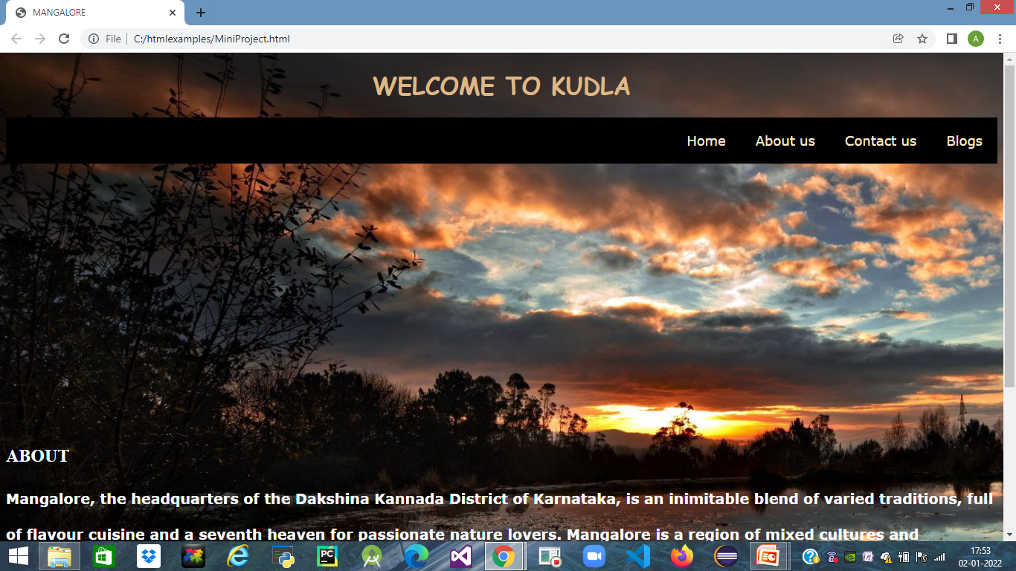
Home page

Slide 6
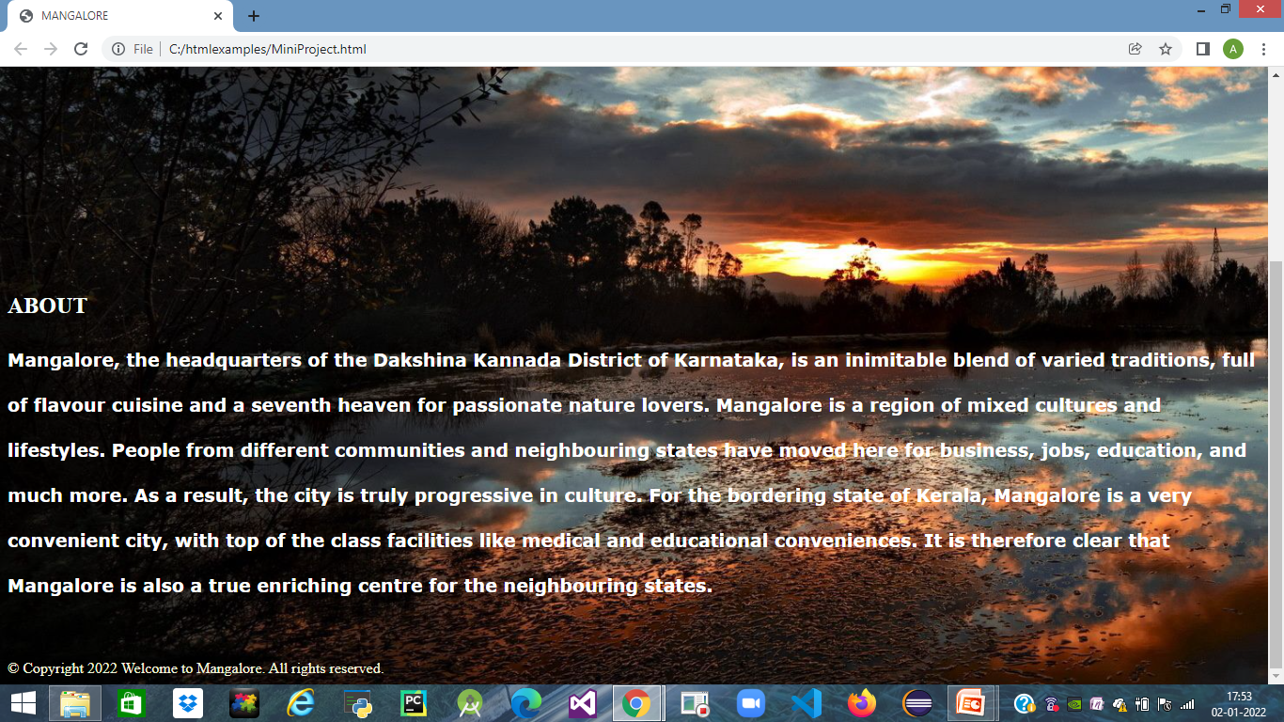
Home page
In the home page we have about, where it has basic information of mangalore.
We do have footer at the bottom of web page.

Slide 7
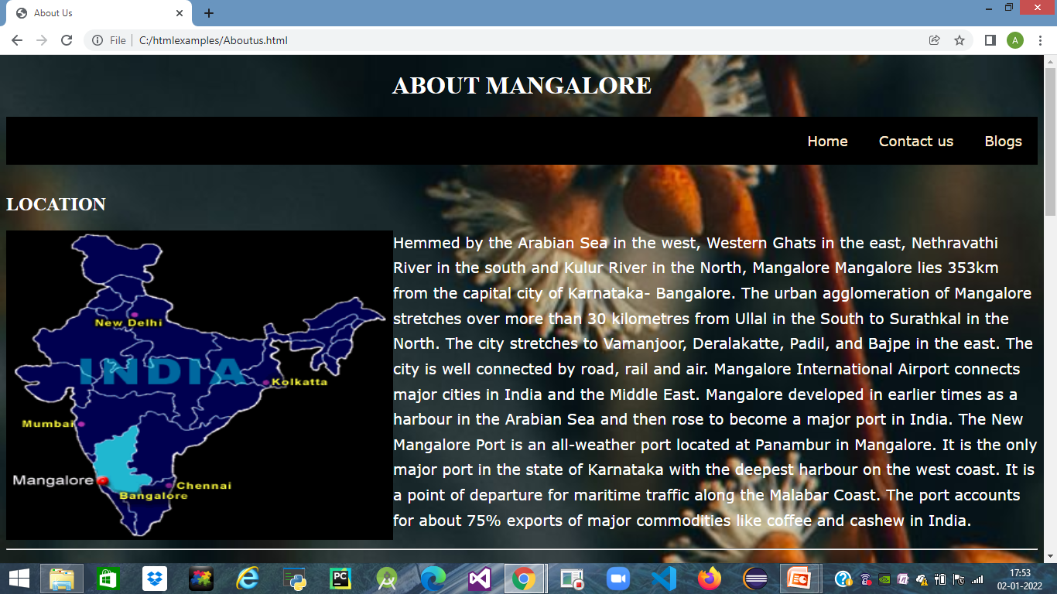
About Us
Brief introduction of mangalore city.
Location

Slide 8
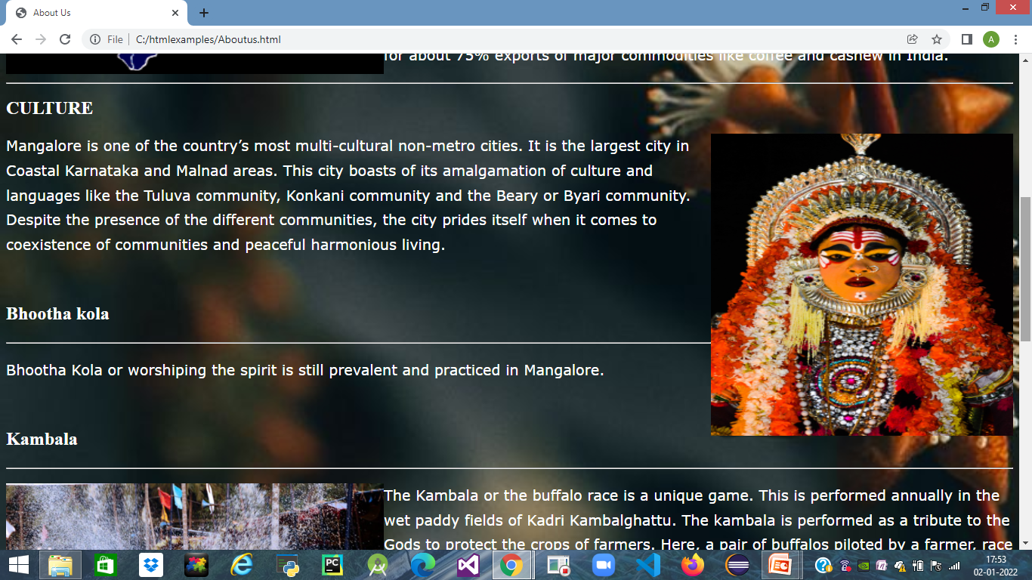
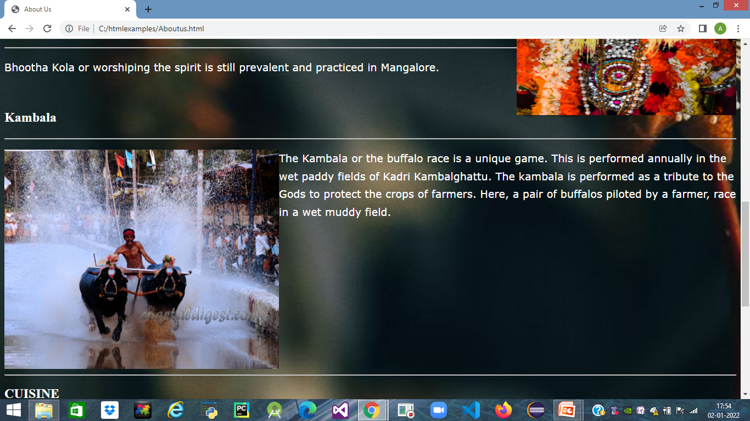
Culture

Slide 9
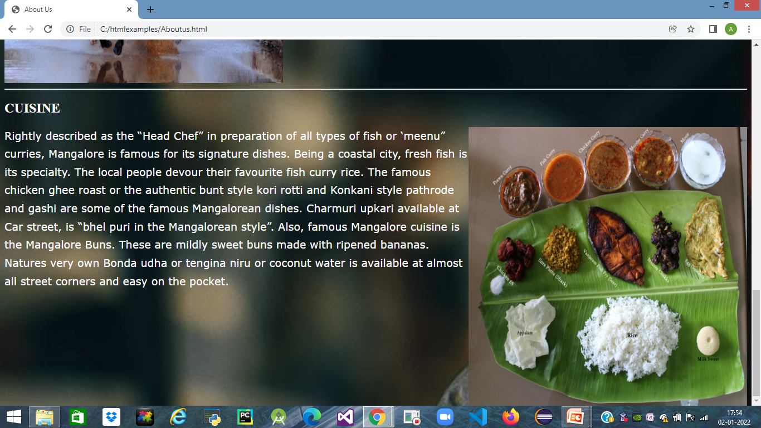
Cuisine

Slide 10
Contact Us
Sign Up form.
First name textbox
Last name textbox
Email ID textbox
Password textbox
Check box
Submit and Cancel button.

Slide 11
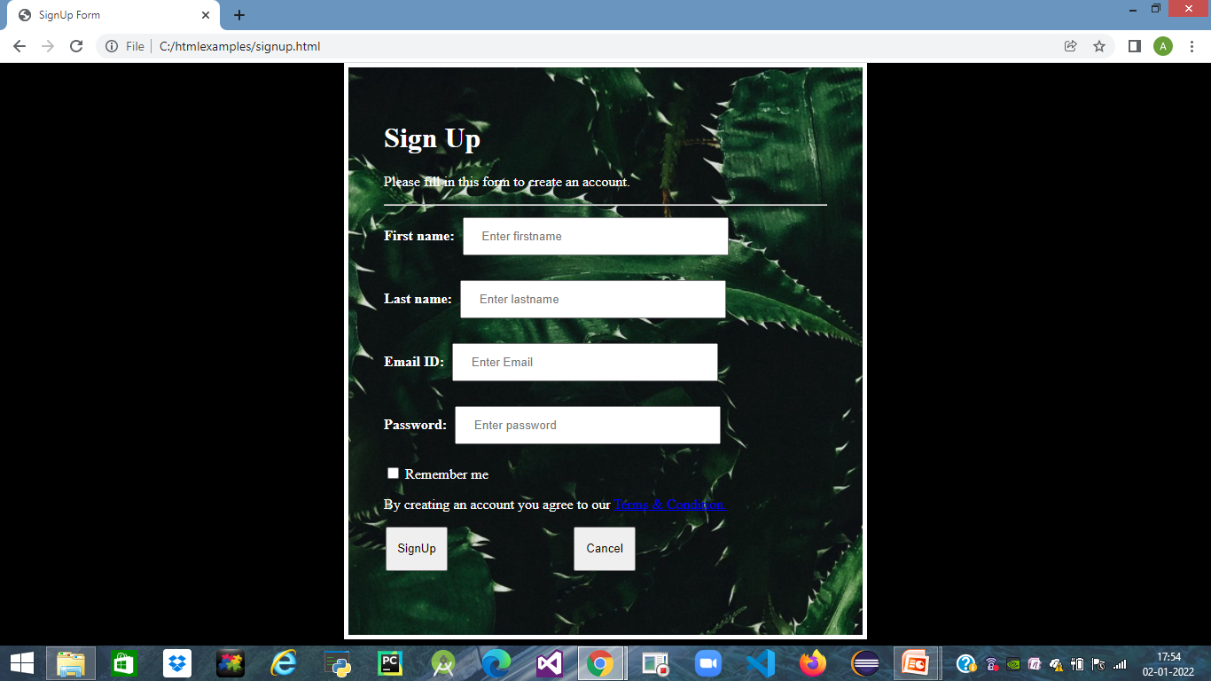
Signup form

Slide 12
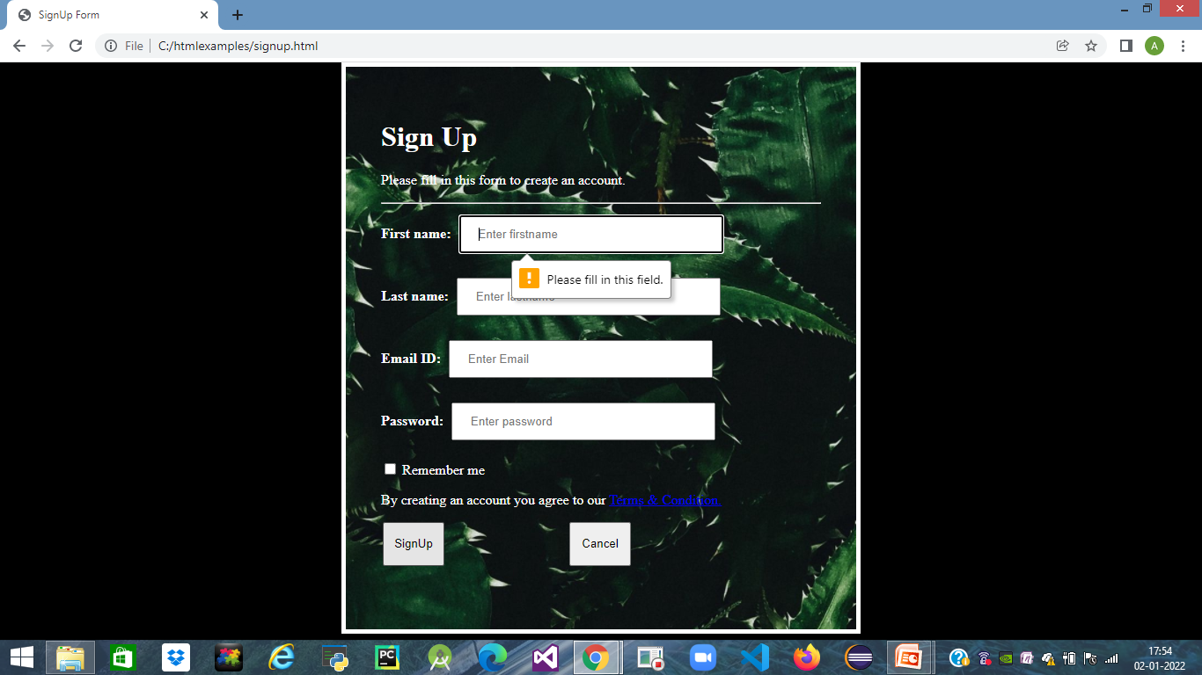
Signup
When I click on Signup button without giving any inputs I will get default message saying that ‘Please fill in this field’.

Slide 13
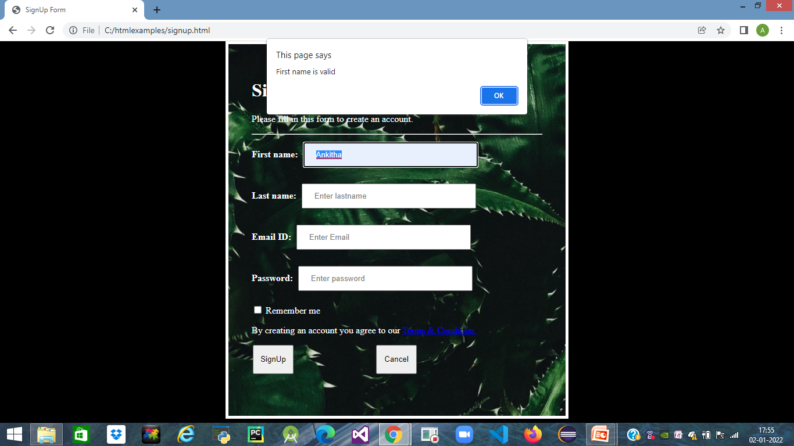
SignUp
If I enter valid input to Firstname,Lastname field I will get alert message saying that valid name.

Slide 14
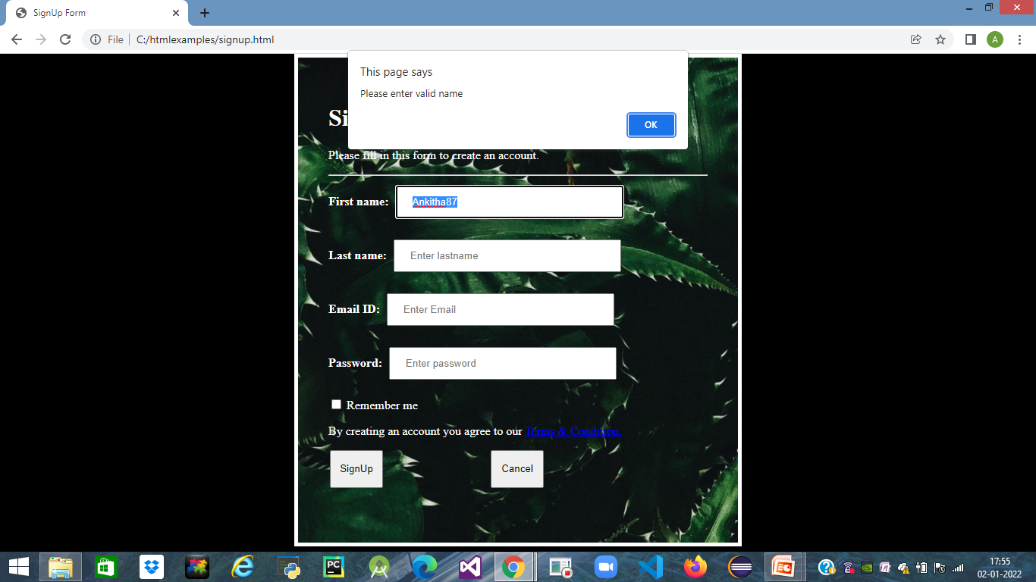
SignUp
If I enter Invalid input I will get error messsage saying that ‘Please enter valid name’.

Slide 15
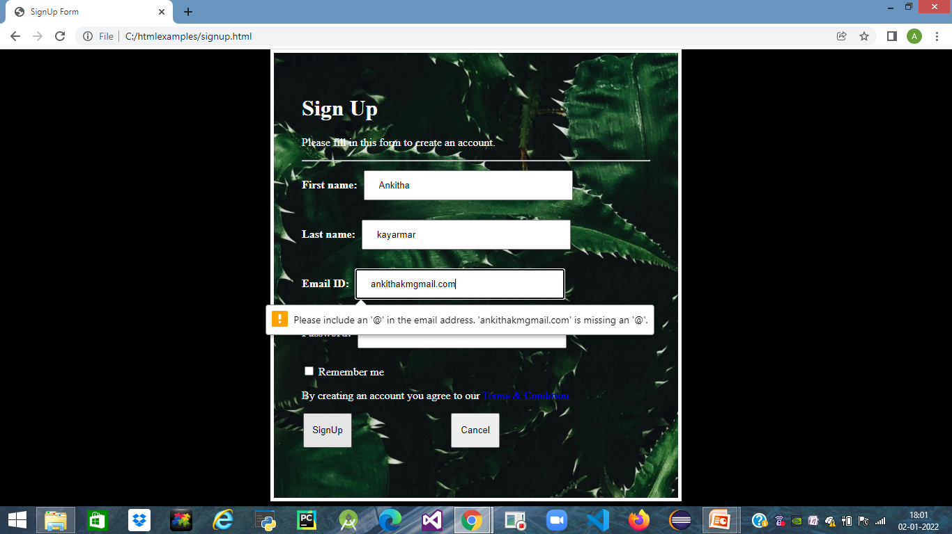
SignUp
If I enter email id without giving address sign i.e,@ alert message will pop-up.

Slide 16
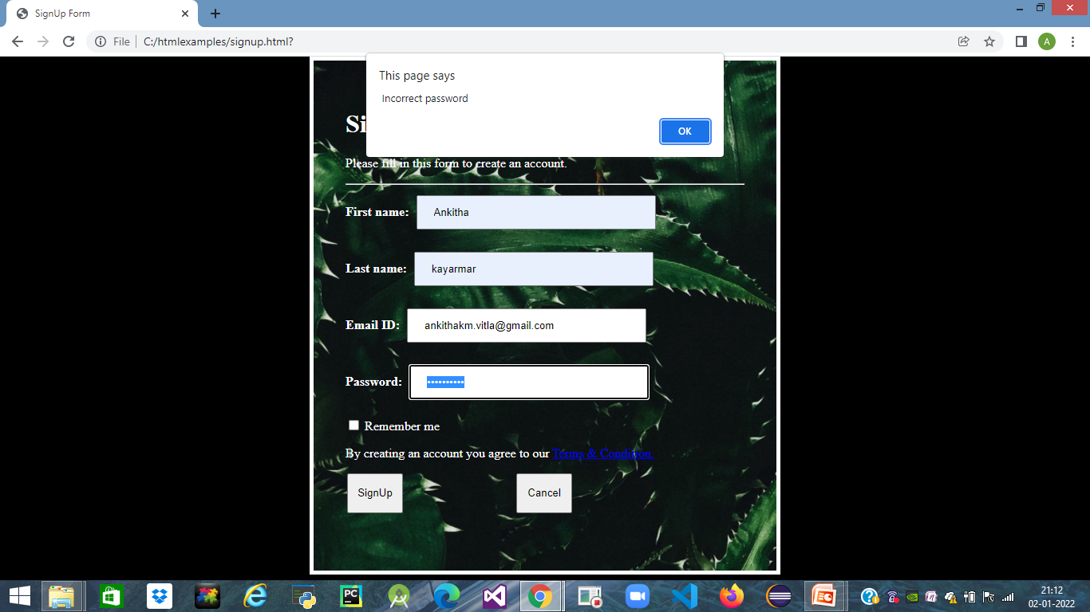
SignUp
In password field if I give any special character then alert message will pop-up.

Slide 17
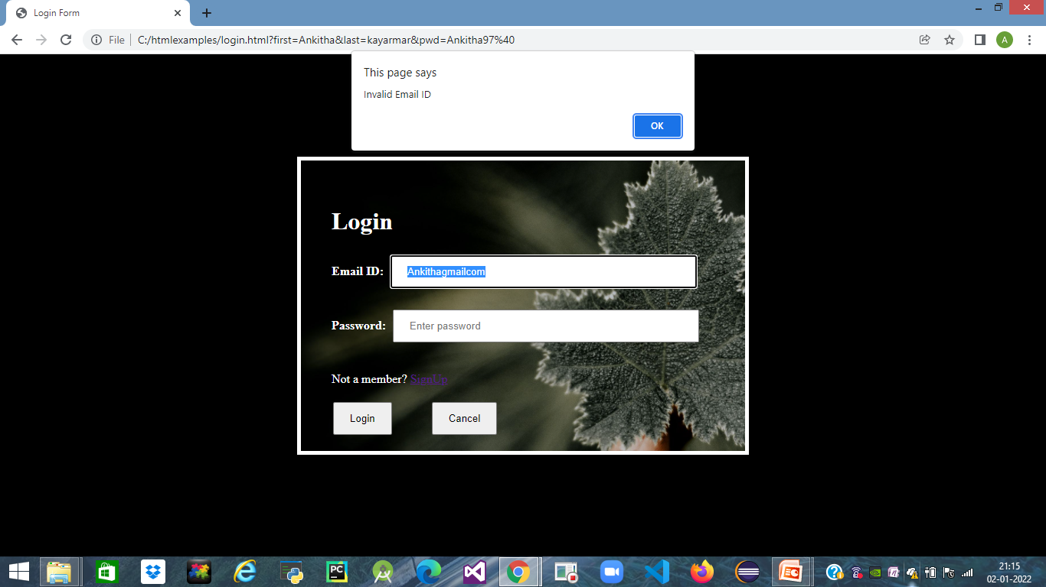
Login
If I provide login without periodic and address sign alert message will appear saying that ‘Invalid Email ID’.

Slide 18
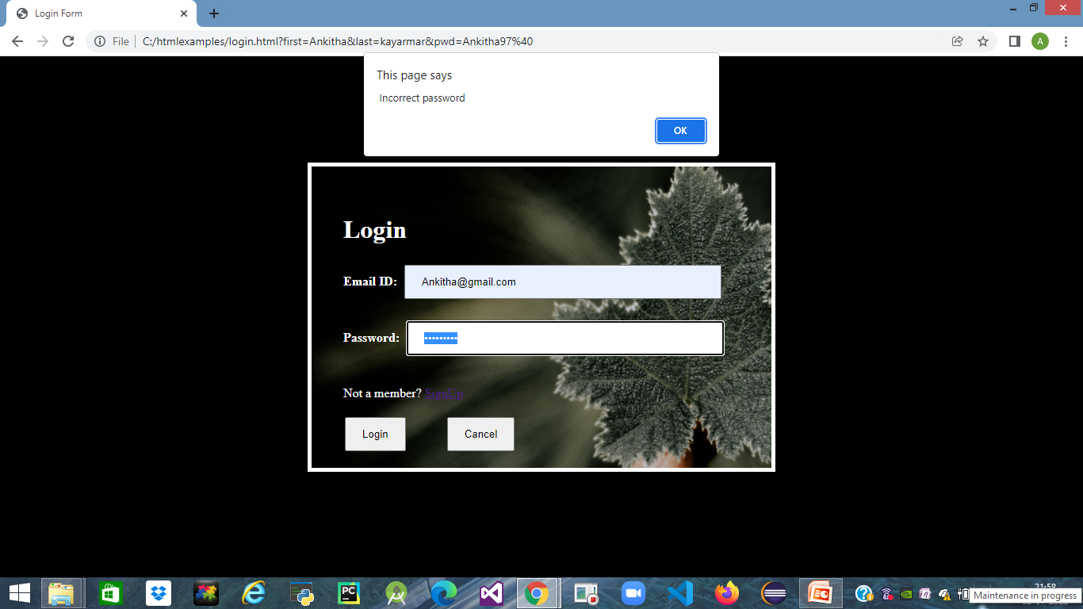
Login
When I enter special character in password error message will appear.

Slide 19
Login
Once after giving valid inputs to login and password ,when I click on login button Blogs page will appear.
Cancel button is to clear entered values.
If any input field is left empty then before submitting the form a error message saying ‘Please fill in this field’ will popup.

Slide 20
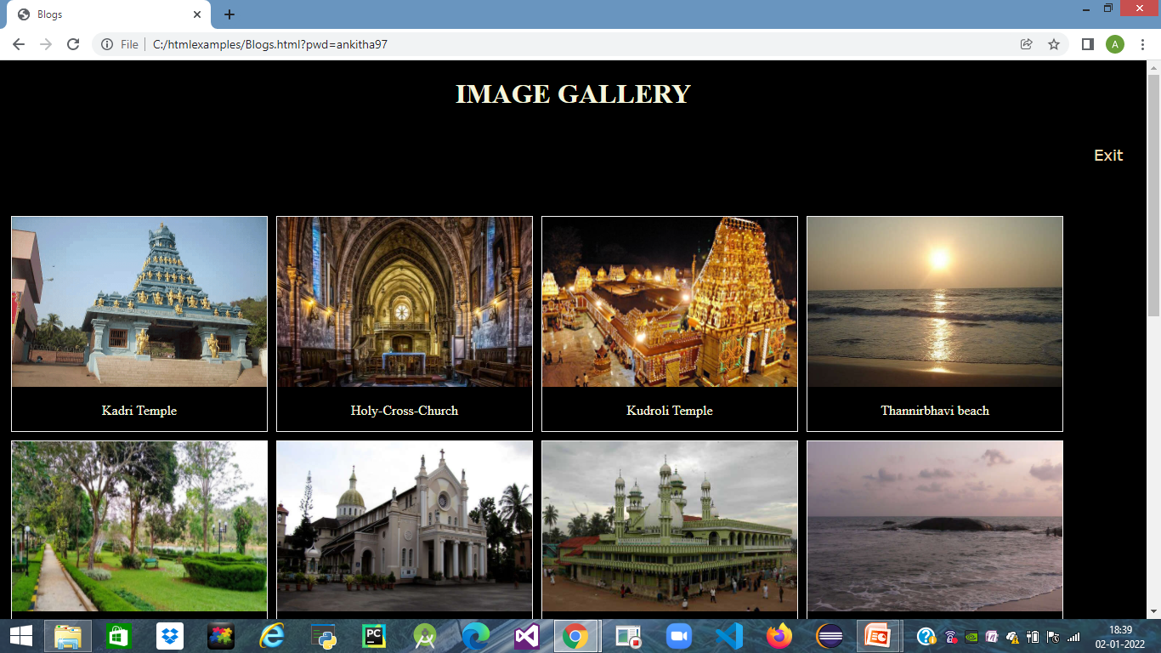
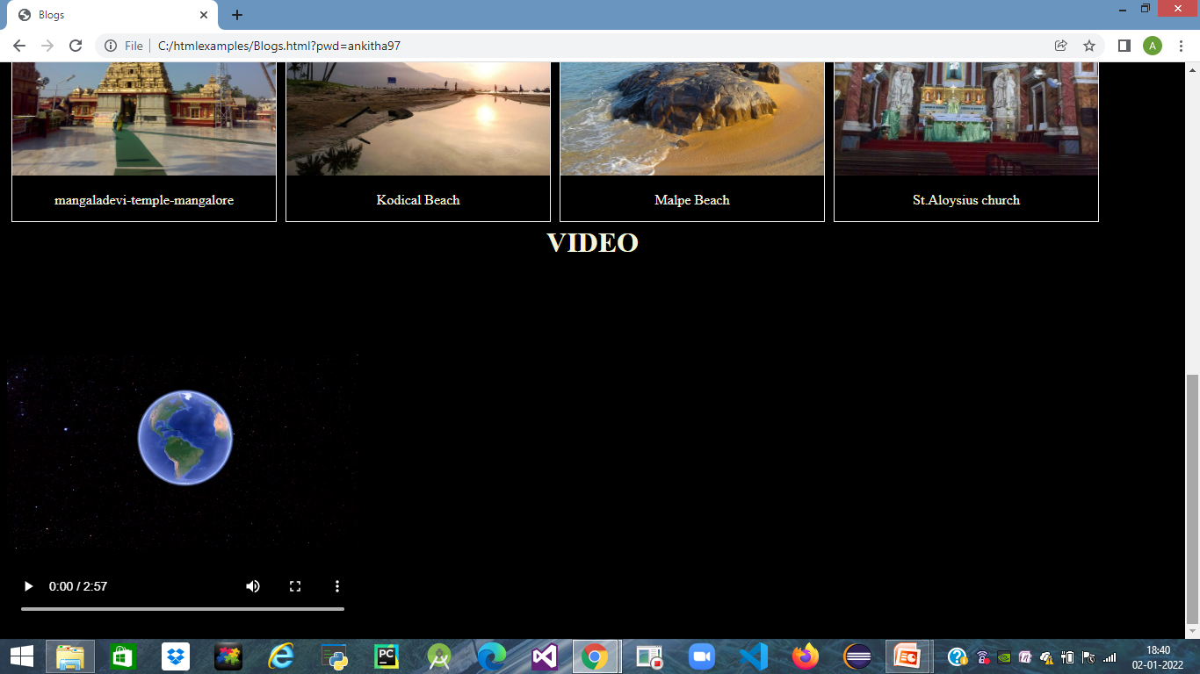
Blogs
Image gallery page with video.

Slide 21
THANK YOU

